Slide 1

Machine Learning for Disaster Detection through Twitter Analysis
Sneha Perithambi
Department of Computer Science
Under Professor
Derek Harter

Slide 2
Outline
Introduction
Implementation
Results
Discussion
Future work

Slide 3
Our research work: Using Natural Language Processing accurately
identify real-time disaster announcements amidst linguistic complexities.
Why this research is important
How can machine learning frameworks be utilized to effectively distinguish between metaphorical language and genuine crisis-related information within tweets during critical events on Twitter? The challenge lies in accurately identifying and differentiating metaphorical expressions from authentic crisis-related information within the vast amount of real-time data flowing through Twitter feeds during critical events. Metaphors, although powerful linguistic tools, introduce ambiguity and complexity, posing a considerable hurdle in the quest for reliable crisis detection.
What we know and don’t know

Slide 4
Our research work: Using Natural Language Processing accurately
identify real-time disaster announcements amidst linguistic complexities.
Twitter has become a ubiquitous platform for event reporting, particularly during critical events such as disasters, facilitated by the widespread use of smartphones. This dynamic environment offers unparalleled opportunities for immediate and decentralized communication, underscoring the pressing need for effective crisis communication strategies to harness the potential of Twitter as a valuable tool for situational awareness and emergency response.
By developing a sophisticated machine learning framework that incorporates natural language processing (NLP) models to capture contextual nuances, it is possible to enhance the understanding of metaphorical language within tweets and accurately distinguish metaphorical expressions from genuine crisis-related information. Leveraging established machine learning classification algorithms and rigorous evaluation metrics, this framework can significantly contribute to improving crisis communication strategies in the digital age.
Our experiment
Our hypothesis

Slide 5
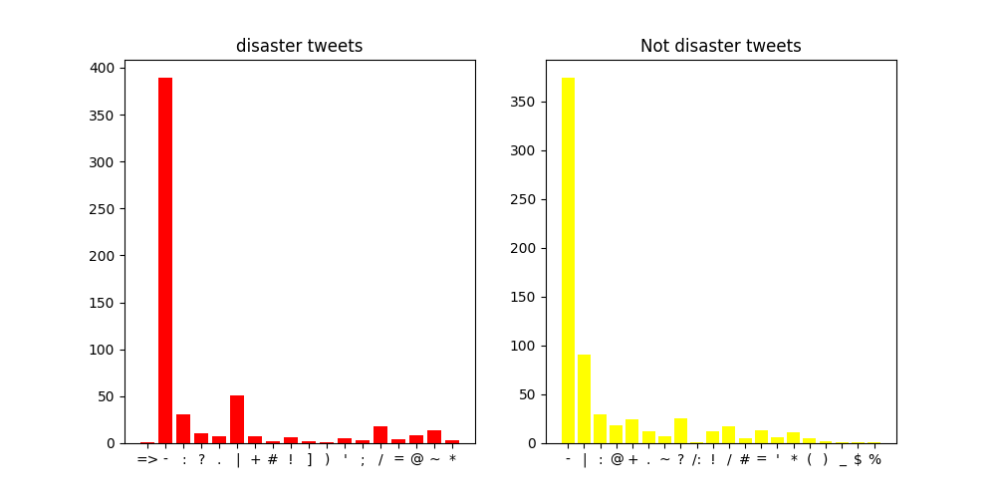
Implementation: binary classification tasks, where the goal is to predict a binary outcome (e.g., disaster or non-disaster) based on input features (e.g., tweet text).
Exploratory Data Analysis
Number of Words in Tweets
Common Words in Tweets
Bigrams Analysis
Punctuations

Slide 6
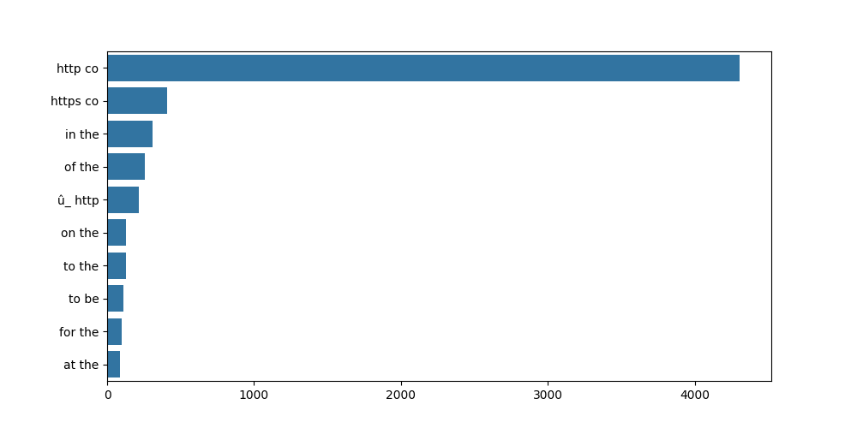
Implementation: binary classification tasks, where the goal is to predict a binary outcome (e.g., disaster or non-disaster) based on input features (e.g., tweet text).
Explorartory Data Analysis
Number of Words in Tweets
Common Words in Tweets
Bigrams Analysis
Punctuations

Slide 7
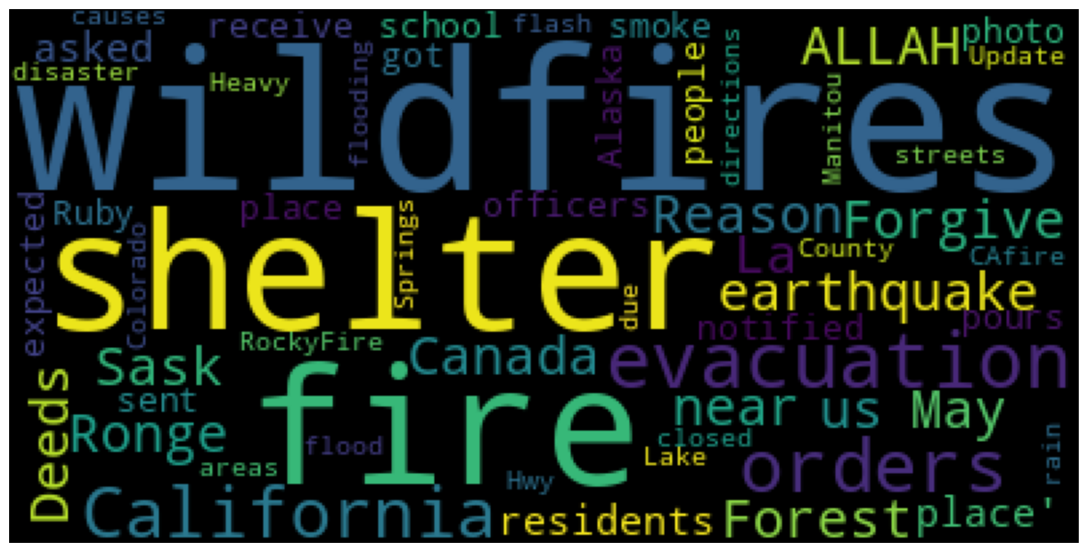
Implementation: binary classification tasks, where the goal is to predict a binary outcome (e.g., disaster or non-disaster) based on input features (e.g., tweet text).
Data Cleaning
Removing Punctuations
Removing URLS

Slide 8
Implementation: binary classification tasks, where the goal is to predict a binary outcome (e.g., disaster or non-disaster) based on input features (e.g., tweet text).
Algorithms
Logistic regression for tweet classification
Logistic regression is a linear classification algorithm used extensively for binary classification.Linear classification is like drawing a straight line on a graph to separate things into different groups based on their characteristics. Imagine you have a bunch of dots on a piece of paper, and some of these dots are red and others are blue. If you can draw a straight line that neatly separates the red dots from the blue dots, that's what linear classification is about. It's a way for computers to learn how to categorize things by looking at their features and finding a simple rule (a straight line) to distinguish between different groups.
DistilBERT for tweet classification BERT (Bidirectional Encoder Representations from Transformers)
"DistilBERT Base Uncased" specifically refers to a smaller, faster version of the BERT model that does not differentiate between uppercase and lowercase letters in the input text. It's often used in various NLP tasks where a balance between performance and computational resources is desired.

Slide 9
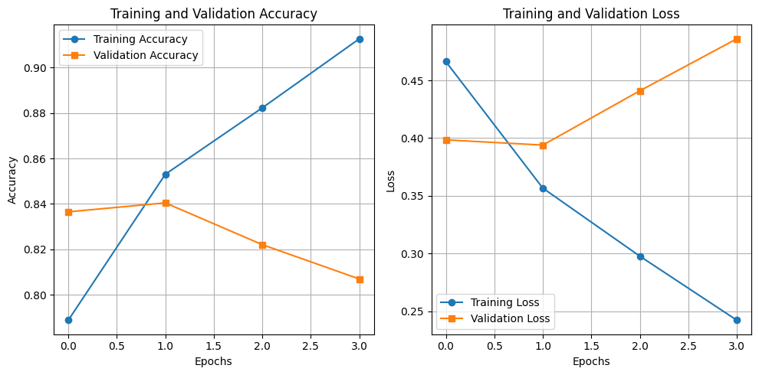
Implementation: binary classification tasks, where the goal is to predict a binary outcome (e.g., disaster or non-disaster) based on input features (e.g., tweet text).

Slide 10
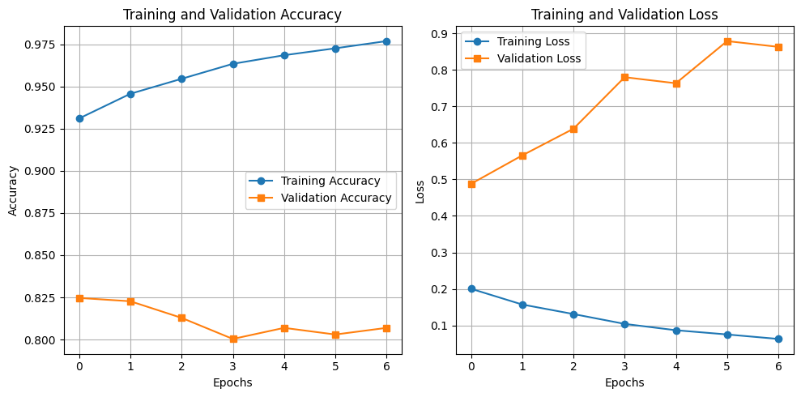
Implementation: binary classification tasks, where the goal is to predict a binary outcome (e.g., disaster or non-disaster) based on input features (e.g., tweet text).

Slide 11
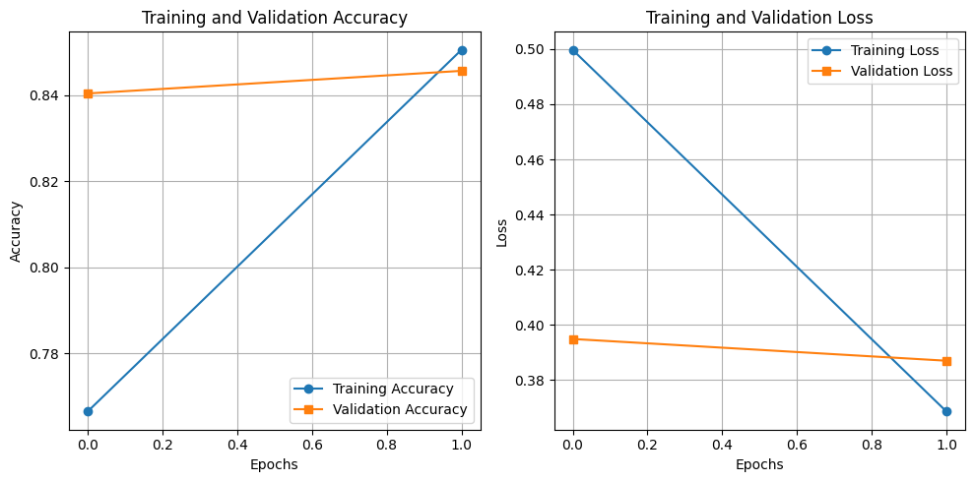
Implementation: binary classification tasks, where the goal is to predict a binary outcome (e.g., disaster or non-disaster) based on input features (e.g., tweet text).

Slide 12
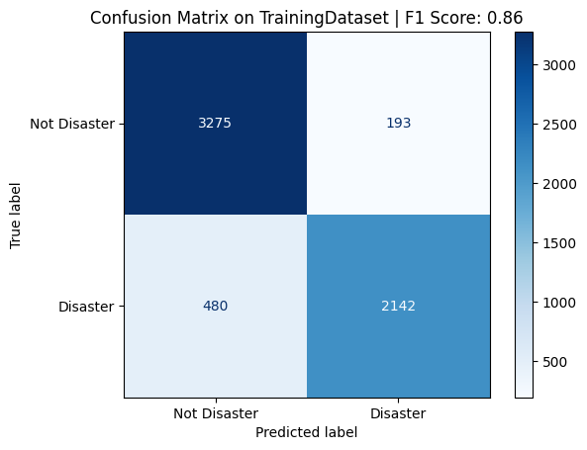

Implementation: binary classification tasks, where the goal is to predict a binary outcome (e.g., disaster or non-disaster) based on input features (e.g., tweet text).

Slide 13
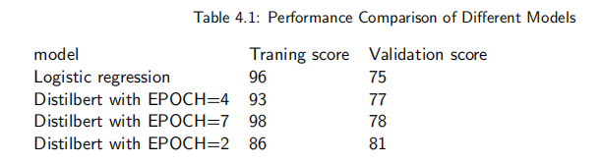
Result:

Slide 14
Future Work:
Analyze different models
Implementing MLOPS
Continuous Model Monitoring: Implementing automated monitoring tools to continuously
track the performance of the deployed machine learning models. This includes monitoring metrics
such as accuracy, precision, recall, and F1-score in real-time, detecting any drift or degradation
in model performance, and triggering alerts for timely intervention.
Automated Retraining Pipelines: Developing automated pipelines for model retraining
using fresh data. This involves integrating data pipelines that fetch new tweet data, preprocess
it, and feed it into the retraining process. Automated retraining ensures that the model remains
up-to-date with evolving language patterns and crisis-related trends on Twitter.

